Slide 1
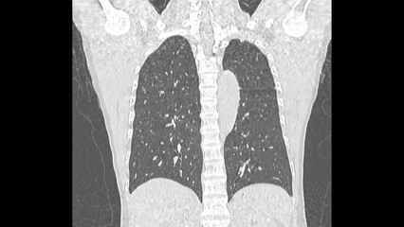

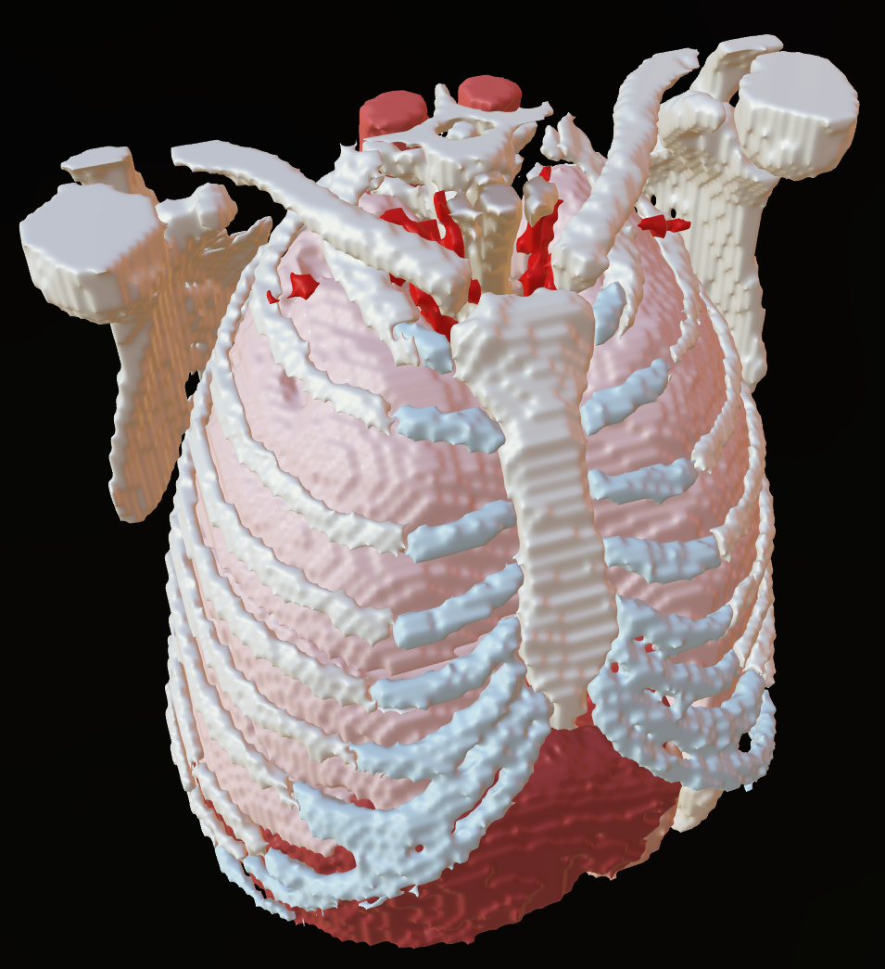
Automating Tasks with Python
Kristen Browne MSc/MScBMC
Contractor - Guidehouse Inc
National Institute for Allergy and Infectious Diseases (NIAID)
Bioinformatics and Computational Biosciences Branch (BCBB)
Notes:
Hi, I’m Kristen Browne, I’m a contractor for Guidehouse working with the National Institute of Allergy and Infectious Diseases in our Bioinformatics and Computational Biosciences Branch. Today I’ll be encouraging to you think about how you can use programming, specifically Python programming, to automate certain aspects of your work.

Slide 2
Had to rename hundreds of files one by one?
Had to handle large sets of similar models repeatedly (e.g. anatomical models created from DICOMs)?
Convert a large batch of files into different formats manually?
Update or add metadata to the headers of numerous files?
Perform the same mesh clean-up, scene set-up, or model preparation repeatedly?
Handle any task that requires repetitive actions or long, tedious sequences of steps more than once?
Have you ever…
Then you should Learn Python!
Notes:
Have you ever had to any of these tasks? Renaming a lot of files, maybe adding a suffix or a prefix? Had to do the same kind of model handling over and over, like adding the same materials to anatomical models? Maybe you’re doing a lot of file conversions so you have models in different formats, handling metadata, cleaning up meshes, setting up scenes… basically anything that requires you to do the same button clicks or steps over and over again? Then you should think about Learning Python!

Slide 3

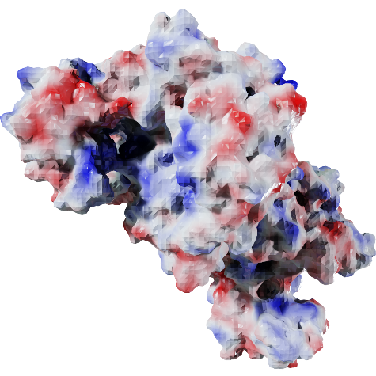
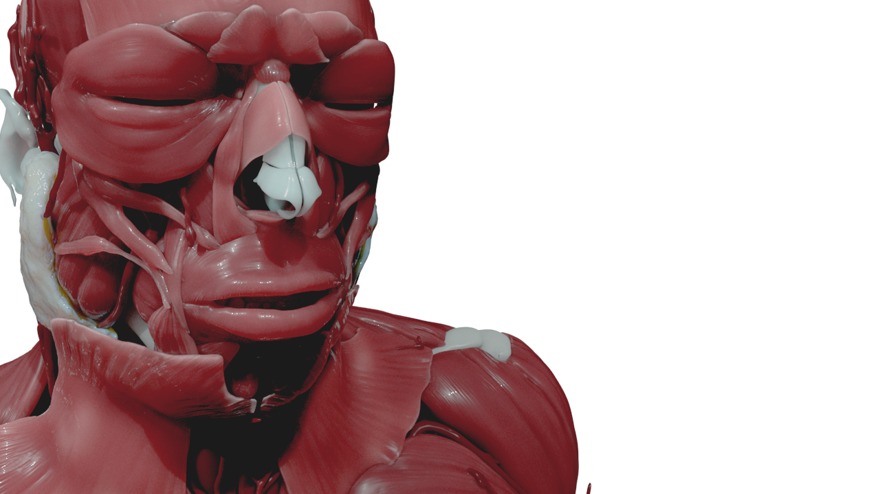
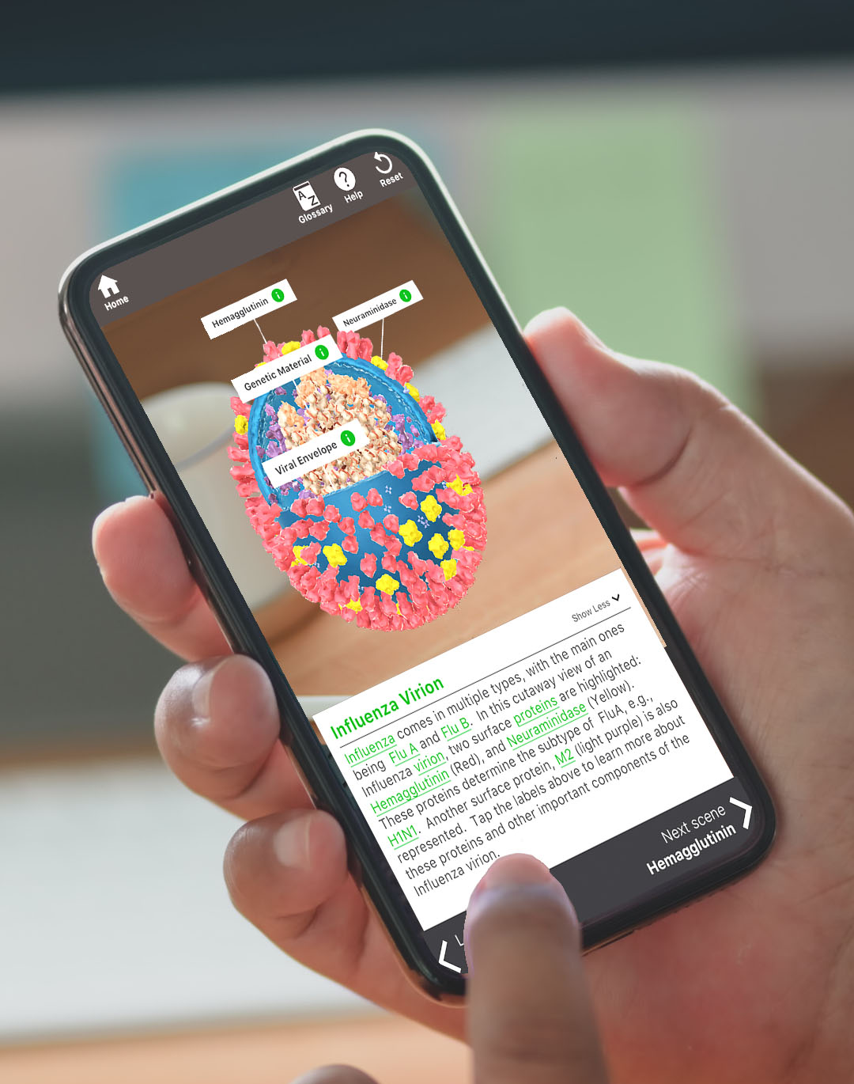
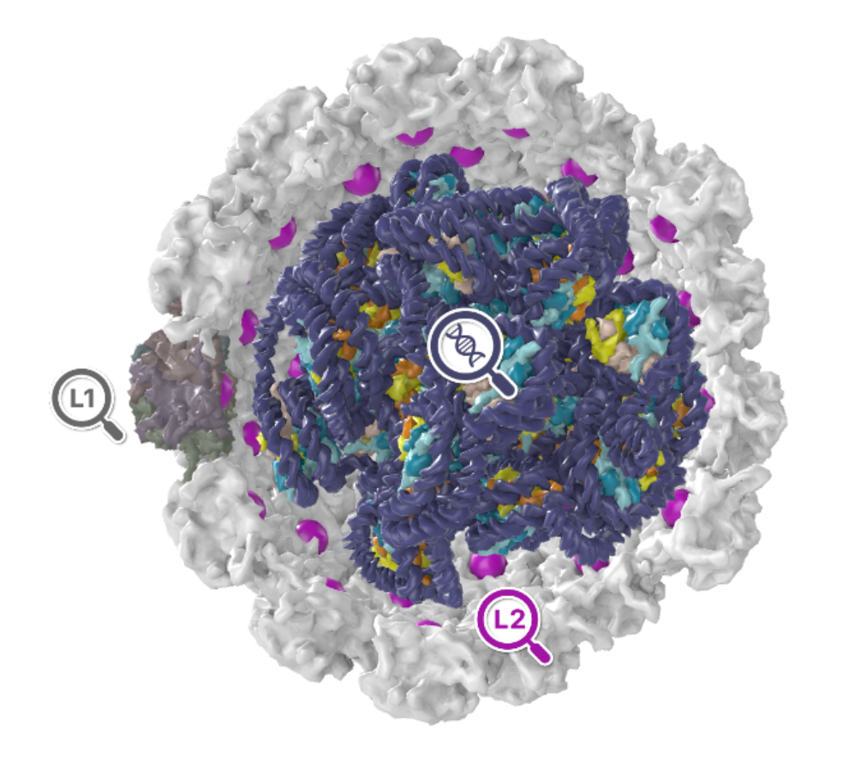

My Journey in Programming
Undergrad
Introduction to Java
NIH 3D Workflows
Python
Building NLM 3D
Javascript, d3.js, MEL, and a bit of PHP, SQL
Mesh repair for 3D printing
File conversions
Decision tree for mesh processing
Rendering
Exporting Textures/Animations
Batch processing
Building Pathogen AR
C# for Unity
CHAT GPT
BioArt Metadata Handling
Python
Building TB in 3D, PaVE 3D, NIH 3D Viewer
Javascript (Babylon.js, Three.js)
Use metadata from hundreds of files to develop organizational structure and retroactively update file headers.
It’s never to late to learn programming
Don’t be discouraged if you struggle at first
Notes:
Many are intimidated to move into the programming space, so I thought I’d share my journey in the field. To be clear, html/css are not programming, programming requires the inclusion of logic, so I’m leaving out my experience there. My first exposure to a programming language was Java in an Comp Sci 100 class I took as an elective. I did not get it. I got through the class with the help of a friend, but the logic just wasn’t clicking. Fast-forward two masters degrees and a change of career and I was at the National Library of Medicine building a 3D model repository. I was on my own building this big web resource including the backend, database and server. I learned just enough Javascript, including d3.js which is a datavisualisation library, MEL which is Maya’s programming language, and a bit of PHP and SQL which run the Content Management Software that I was using. It was trial under fire, but I was starting to click with the logic that underlies all programming lanuages. Next I landed at NIAID and was asked whether I could pick up a Unity project from a developer that was struggling. This is when I had to learn C#, mostly from forums and code examples in GitHub, next up I wanted to start creating 3D visualizations for Web, so I delved into some more javascript libraries, Babylon.js, and Three.js. At this point it’s getting easier to move between languages as they share a lot of underlying rules, just slightly different syntax. Finally, I started working on NIH 3D and we had lost access to the mesh repair for 3D printing software we were using, and we needed a solution fast. So I opened up Blender and learned how to use the Python interface to build a custom mesh repair system. From there, I started working on a complete rebuild of our current workflows that handles all kids of different operations. About midway through this part, Chat GPT came out and accelerated my development enormously., From there I started using Python for all kinds of things, like analyzing the metadata in the files were ingesting into our new BioArt project to look at keywords and think about how we can design an organizational strategy for these files. So it’s been a long journey now, building upon what I’ve learned at each stage. But When I first tried, I didn’t think I’d ever get where I am now, so the lesson here is it’s never to late to learn pgramming (I was probably 32 when I started), and don’t be discouraged if it’s hard at first.

Slide 4
Python
This is NOT a code talk
What will be discussed:
What is Python?
What are some simple scenarios where it’s helpful?
Building examples of building up a workflow in Python
Notes:
So lets start with what is Python. This is not a code talk. I will show you code, but I’m not going to walk you through it. I want you to have a sense of what Python is, where its helpful, and how you can use tools like AI to start to build your own programs. Learning python and how to set up your environment is another subject and there’s lots of resources available online.

Slide 5
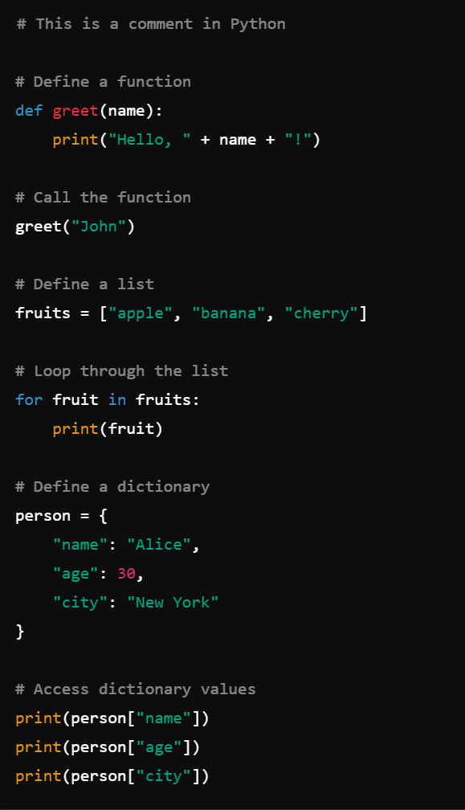
What is Python?
Programming Language: A structured set of instructions that a computer can understand and execute
High-Level Programming Language
Python is easy to read and write due to its high-level nature, which abstracts complex details from the programmer.
Interpreted Language
Python runs without needing compilation, allowing for faster development cycles. However, its interpreted nature can make execution slower compared to compiled languages.
General-Purpose
Python is widely used across various fields such as web development, research, data analysis, scientific computing, and 3D modeling/animation.
Cross-Platform
Python is compatible with multiple operating systems, including Windows, macOS, and various Linux distributions.
Extensive Libraries/Modules
Python has a rich ecosystem of libraries and modules, including Pillow and OpenCV for image processing, and MeshLab (pyMeshLab), Blender (bpy), and Trimesh for 3D model processing.
Notes:
So first up – What is python? It’’s a programming language which is essentially a structured set of instructions for a computer to understand and execute. Python is a high-level language, which makes it easier to read than lower level languages like assembly, machine code, C, and other more hardware-centric languages. You can see on the right a simple example of python code and it’s very readable with relatively simple logic. It’s an interpreted language which means that it doesn’t need to be compiled. Anyone who has worked in Unity has known the pain of waiting for a program to compile before it can be tested. This has benefits and drawbacks as it’s faster to development, but can have slower execution times. It is a widely used language bridging many fields that touch on medical illustration. You’ll see python interfaces in software like Maya and Blender as they move towards using a common language. It is also cross-platform, so no worries about the great Mac/Windows debate. I use Windows, but all of the developers I work with use Mac (which is common in bioinformatics). It isn’t generally a program for us to share code, but we do need to set up our environments a bit differently sometimes. Finally, python has extensive libraries that are applicable to our field including data viz, image, 3d graphics processing.

Slide 6
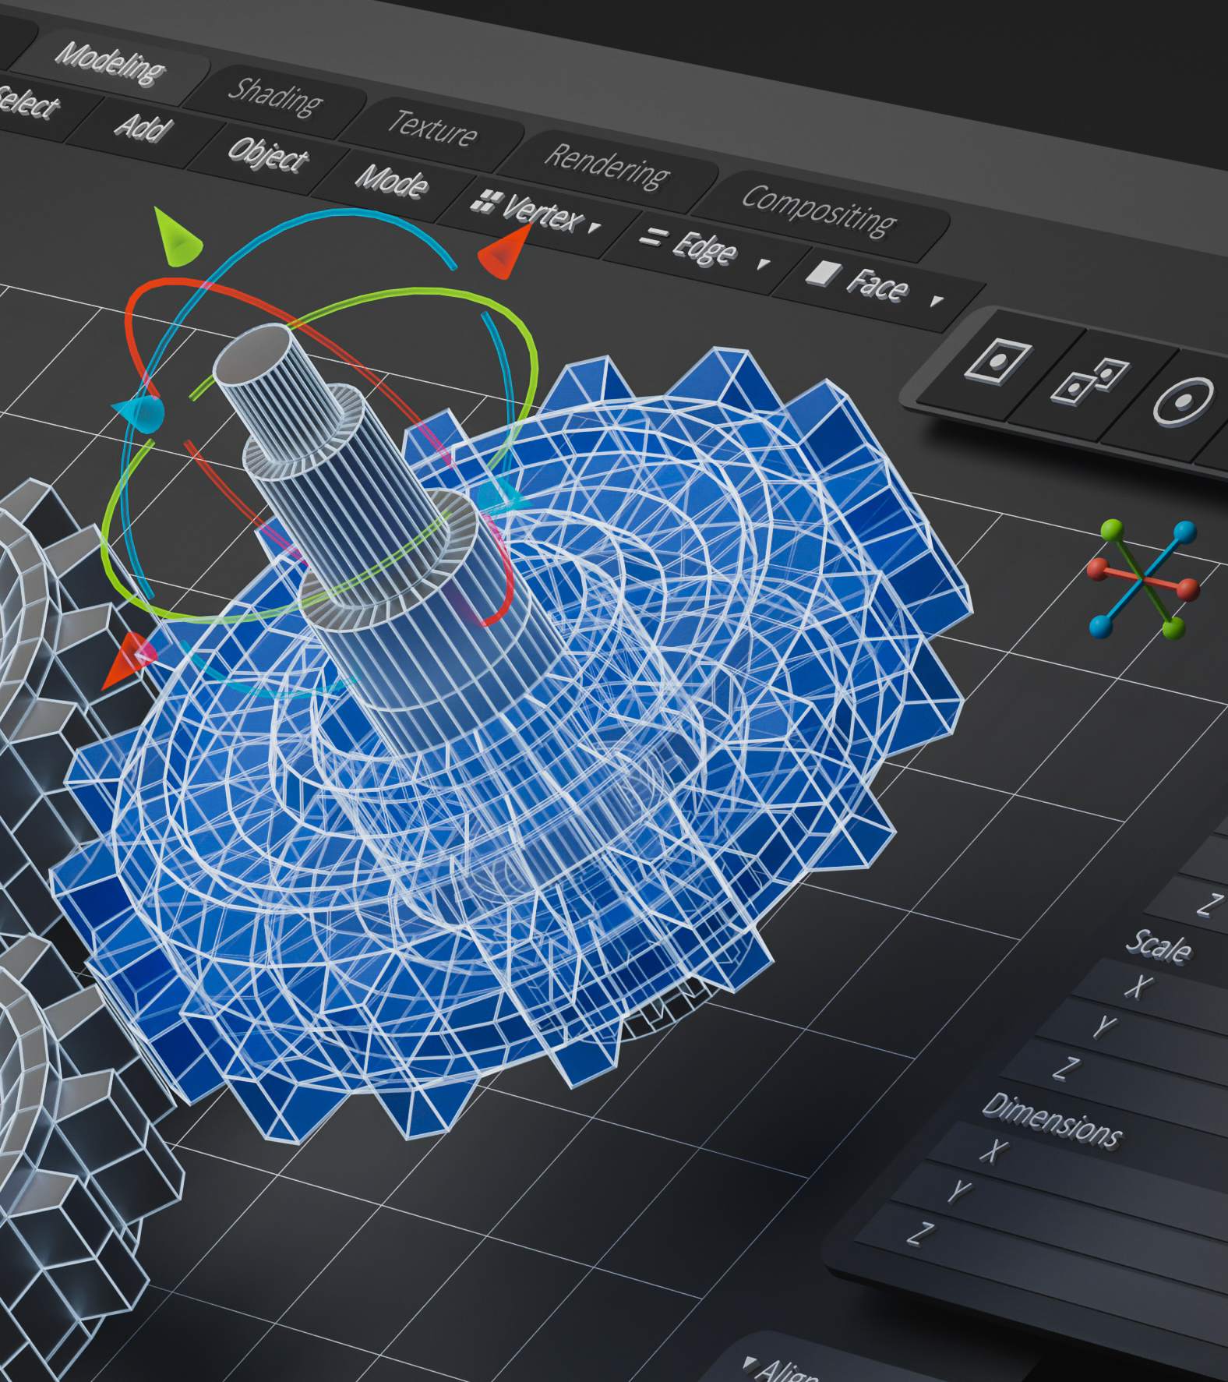
How can I use Python?
2D Image Manipulation
Image resizing, cropping, enhancing, filters, and exports
3D Model Creation/Manipulation
Rendering/Animation/Simulation
3D mesh optimization
Medical Imaging
Molecular Modeling
Data Visualization
Organizational tasks
Batch Processing
Workflow development
And more!
Notes:
So how can you use python?
2D image manipulation is a start, there’s several packages available to do various processing tasks, including a python API for Adobe products like Photoshop.
3D model creation or manipulation – there are many tools for doing mesh optimization tasks, the blender API is excellent and can do anything Blender does without even launching the .exe. You can do medical image processing and model creation with packages like slicer, VTK, simpleITK (which we develop), and you can also do molecular modeling and simulation tasts. I’ve listed in bold the ones that I’ve used personally.
Finally, you can use these tools for batch processing of many files, you can link them together into larger workflows, you can do a lot of data visualization tasks with Python. You may have heard of R, but many are moving over to doing that kind of work with Python, then there are a lot of organizational tasks. Python is really good at manipulating files, so I use it for things like metadata, renaming files, organizing files, zipping/unzipping, that kind of thing. There’s definitely more out there, but these are the ones I’ve touched on in my day to day so far.

Slide 7
Where does AI Fit in?
It is an UNMATCHED learning tool
Code drafting
Debugging
Learning new APIs (Application Program Interface)
Idea generation
Add comments and creating documentation
What are the limitations?
It’s an assist, not a replacement (yet)
It may have out of date information or create commands that don’t exist.
Data Privacy / Security
Your queries and it’s outputs are limited in size.
Notes:
A big question these days is how does AI fit in. I’m not talking bout graphics generators like Midjourney as that’s a different conversation. This is about Code generation tools like GitHub Copilot, although you can just directly ask ChatGPT as well. AI is an absolute gamechanger in the coding world. It is excellent at drafting code, debugging, and commenting tool. It can help you learn syntax, especially new APIs (basically the programming commands used by specific programs like blender), and it can also help comment your code which is an essential part of the documentation process. But it’s not perfect. It’s an assist, but not a replacement. I say yet because you need to consider that it is very very good and it is currently the worst it will ever be. But for now, it isn’t always up to date and can reference outdated commands. It’s limited to what it is trained on, so if you’re doing something novel, you need to lead it through what you want it to do. There are privacy and security concerns detpending on how you want to use your code, and it also takes limited inputs and output sizes so you can’t just drop in an enormous program and expect it to work. It’s about snippets.

Slide 8
Examples Check
URL to GITHUB REPO
Notes:
From here, I’m going to walk you through an example of how you can slowly build up a useful program. All of the code is in GitHub at this URL. GitHub is a code repository and a tremendous resource for anyone developing code. It keeps a history of all changes you make in your programs and also allows for collaborative work. And it’s free (mostly).

Slide 9
Most Important thing is…
LOGICALLY BREAK DOWN TASKS
Almost like button clicks…
NOTE:
These examples are for BEGINNERS. I am going to be simplifying as much as possible.
Notes:
The most important thing for developing a program is to break it down into logical tasks like button clicks. I click this, then this, then this. There are ways to be more efficient in code, but this is for Beginners, so I want to make this as simple as possible. If your code works, it doesn’t always have to be the most efficient to get the job done. Especially for personal/internal use.

Slide 10
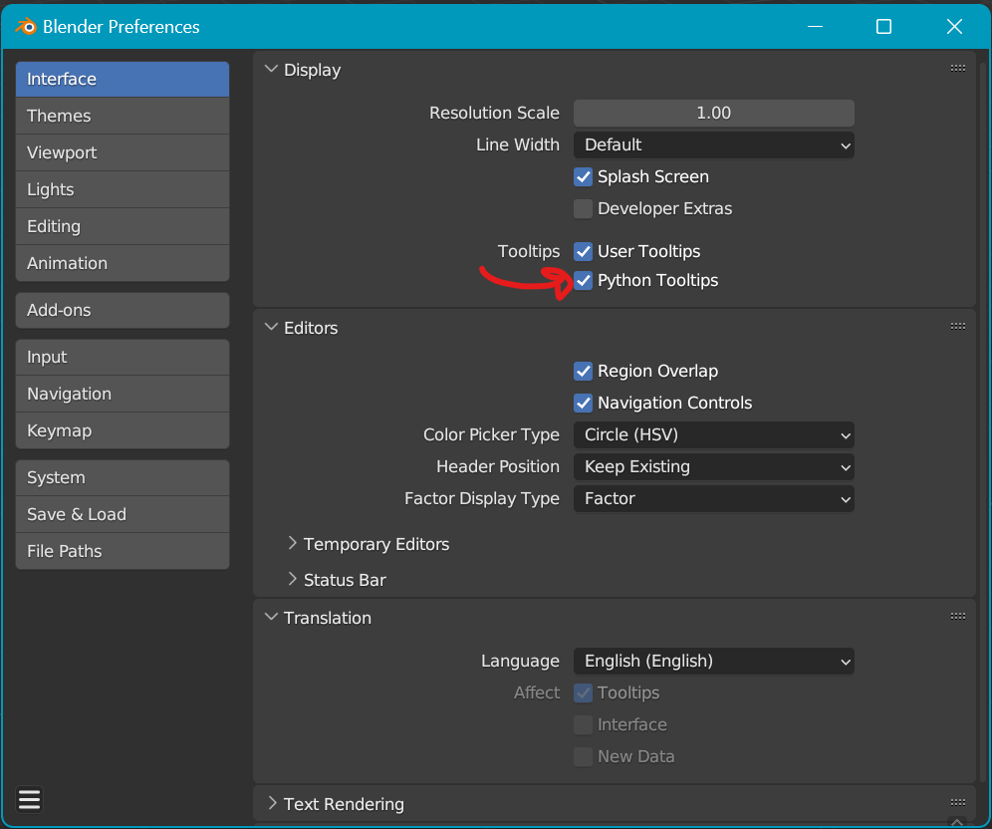
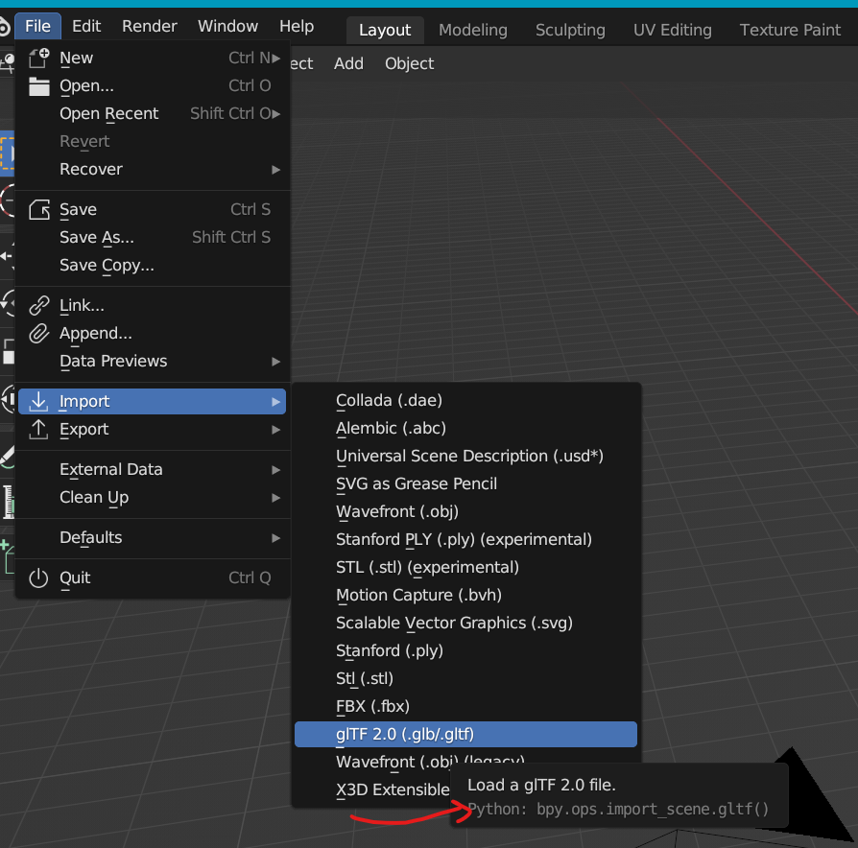
Convert a Directory of 3D Files
Problem: I have a directory of GLB files that I need in FBX and DAE format.
What does the code need to do?
The same thing a GUI would need to do (In Blender you can use the Python Tool Tips)
Import the file from a provided location
Export the file (you provided where and what the file should be called)
Remove everything from the scene
Import the next file…
Blender-Specific Issue -
Make sure that Blender doesn’t lose context
(it needs to be in the correct “mode”)
Notes:
The first program I’m going to write here, is a program to convert a directory of GLB files into FBX and DAE format. So how do I start? I need to think about what the program needs to do, this time in the context of Blender as I’m going to use the Blender API (you could use others). If I were in Blender, I would import a file from a specified place, I would export the file to a specific place and say how to name it, then I’d remove everything from the scene and import the next file. There is a Blender-specific issue where you need to be in different “modes” when doing certain tasks and this is called “context”. It is helpful to remember this. You may be wondering, how do I know what commands to use? In Blender, you can turn on Python tooltips, then when you hover over any item in the menus, it will show you the command! You can also look into their API documentation, or better yet, start with some AI!

Slide 11
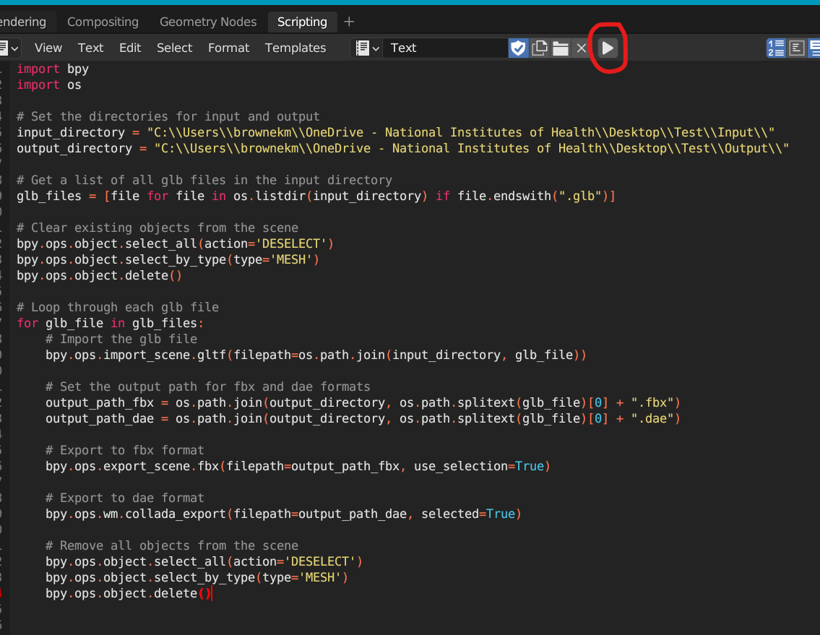
Ask Chat GPT
“Could you write a Blender script that would import each glb file from a provided directory, then export that file to a different specified directory with the same name in fbx and dae formats. Make sure to remove all of the objects from the scene between imports and that the objects are in the correct context.”
BE AS EXPLICIT AS POSSIBLE
Take it slow
Works right away!
Converted 12 glb files (2-17KB) into 24 output files in < 10sec
What Next–
Ask Chat GPT import/export more formats!
Notes:
When talking to a code generator, it’s key to be explicit and not ask too much. In the above prompt I ask it very specifically to so all of the things I summarized in the previous slide, and this is what it spat out. I dropped this in the scripting window in Blender, provided the input and output directories, then hit “play”. It worked immediately. I didn’t even have to change it. It output 24 files in less than 10 secs. It doesn’t always work right away. Before I asked it to specify context, I had a context error so I dropped that into the ChatGPT window and it told me what was wrong. Sometimes this takes a few tries, sometimes it doesn’t work, but it always helps! What might we want to do next? You could add more formats, make sure it clears everything from the scene (not just mesh files)… lots of things1

Slide 12
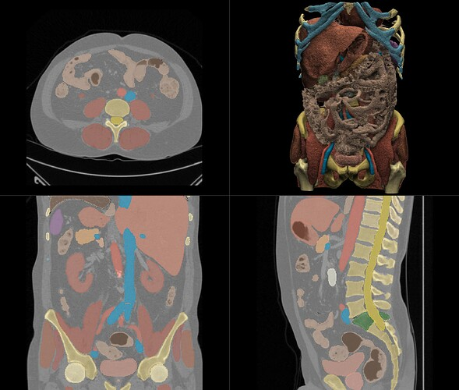
AI Segmentation with Total Segmentator
Apply Materials to a Set of Models
Problem: I have a set of DICOMs that I have segmented using 3D Slicer. For each set of models, I’d like to import all the STLs into the scene, apply materials to the different organs, smooth the models, then export as a single GLB.
3D Slicer Integration:
discourse.slicer.org/t/totalsegmentator-v2/32470
Prep your Files:
How does the system know files are in the same set? (Folder? Prefix?)
Name your 3D files consistently (liver, lung…)
Define a set of materials, noting their specifications
What does the code need to do?
Define the input and output directories and what to name the outputs
Define the materials you want to use
Got through each set and do the following:
Import all STLs in the same set into the scene
Assign materials to the meshes based on the node name
Export as GLB
Remove the mesh objects (don’t delete the materials ☺)
Drag and Drop Interface
totalsegmentator.com/
GitHub Repo
github.com/wasserth/TotalSegmentator
Notes:
Lets try a more complicated example. I have a set of DICOMS that have been segmented using this AI tool, Total segmentator. I want to take all of the STLs that were generated, import them into Blender, assign materials based on the names of the files, smooth shade them, then export them together as on GLB. To do this requires some prep. If I have many sets of STLs, I have to decide a consistent organization so that the program knows how to delimit them. I used folders, but you could use prefixes and other ways. You need to label your files consistently so it knows how to apply the materials (TS does this already), then if you want specific materials, you want to define these up front noting their specular, metallic, color etc. so you could feed it in.

Slide 13
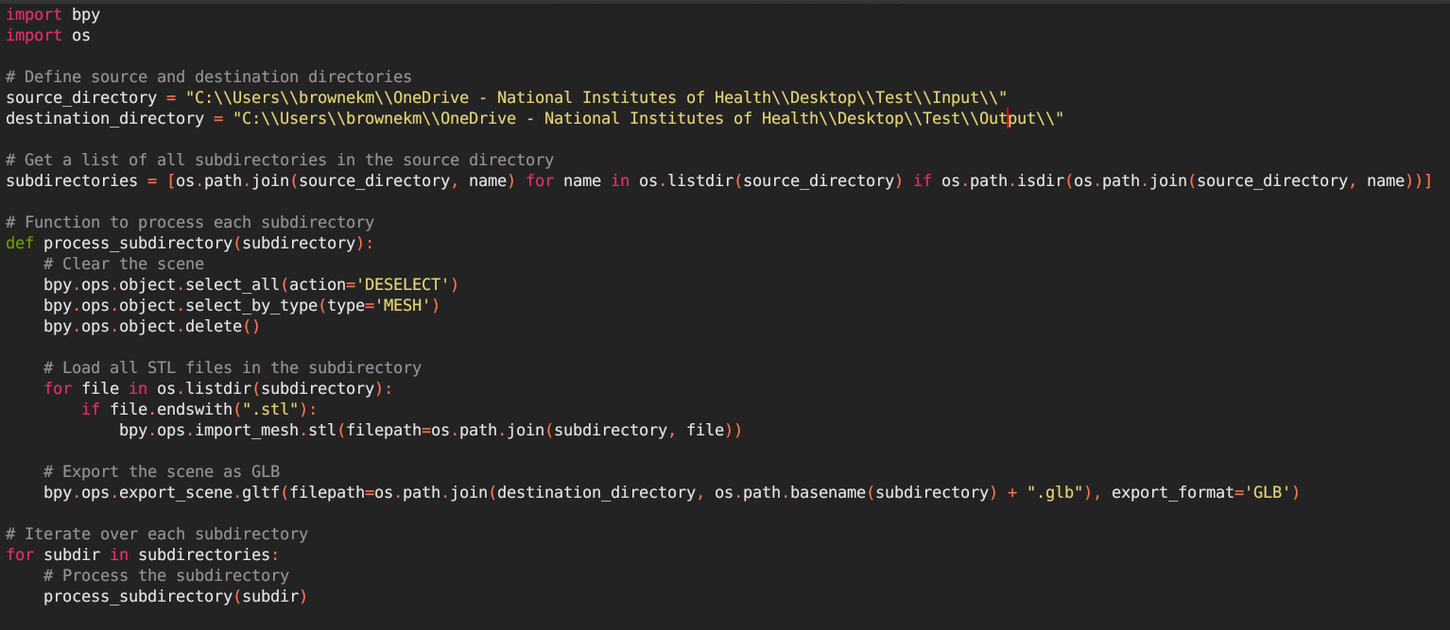

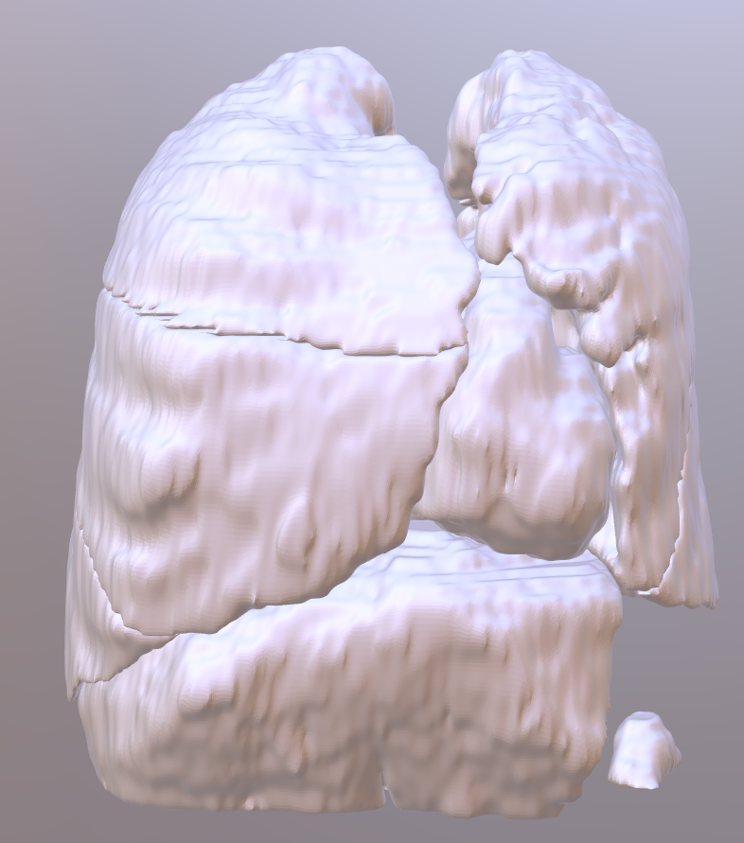
Ask Chat GPT Slowly…
“Write a Blender script to systematically process a designated directory containing multiple subdirectories.
The script should traverse each subdirectory and perform the following tasks:
1. Load all STL files found within the subdirectory.
2. Export the scene as a GLB file named after the subdirectory.
3. Place the exported GLB files into a specified folder.
4. Clear the Blender scene of all mesh objects before moving to the next subdirectory.
It's crucial to ensure the script maintains the correct context throughout the execution.”
dicomSTLtoGLB_stage1.py
my_dicoms
dicom_1
my_glbs
liver.stl
heart.stl
colon.stl
inferior lobe of left lung.stl
inferior lobe of right lung.stl
…
dicom_1.glb
dicom_2.glb
dicom_1
liver.stl
heart.stl
colon.stl
inferior lobe of left lung.stl
inferior lobe of right lung.stl
…
Notes:
For this you can ask ChatGPT slowly. Lets start with some basic instructions to load all of the stls found in a subdirectory and export them as a GLB. Do it for all of the subdirectories in the provided directory. Here’s what we end up with! It works right away.

Slide 14
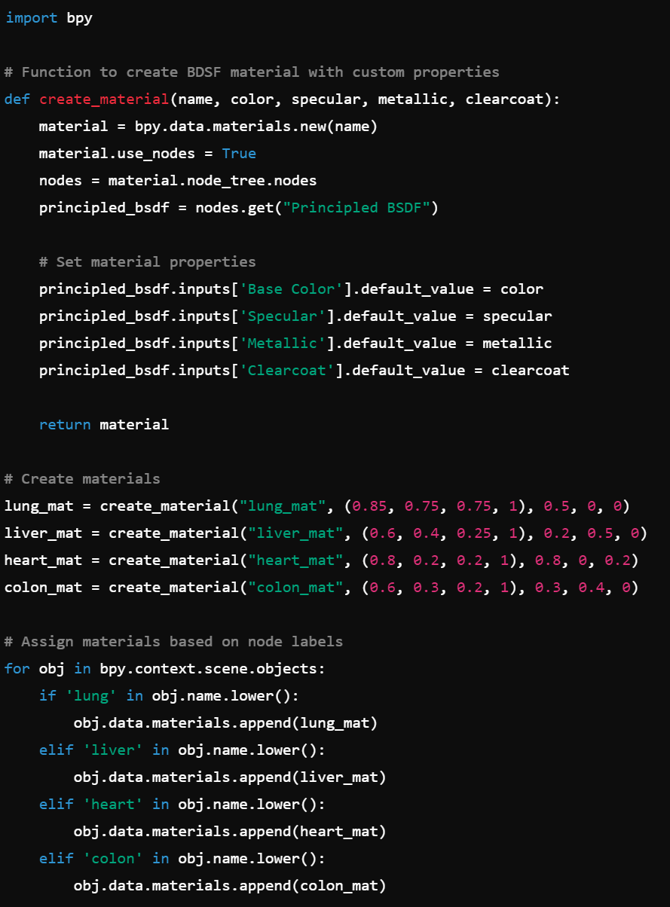
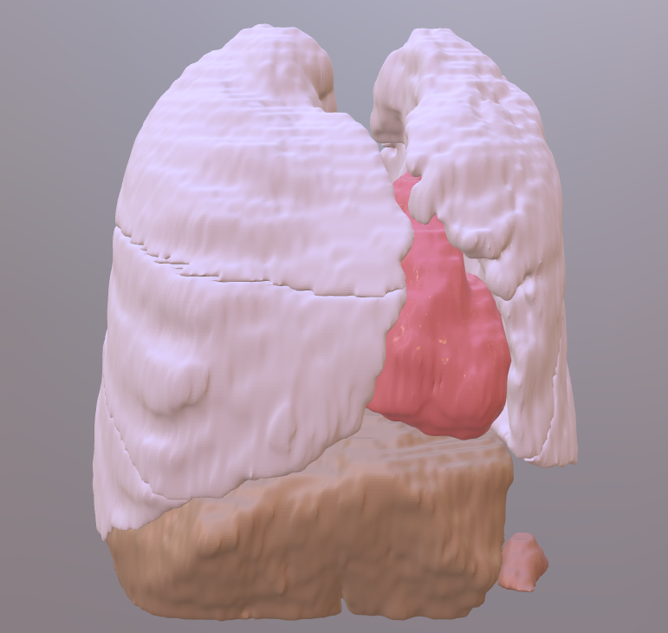
Ask Chat GPT Slowly…
dicomSTLtoGLB_stage3.py
“Develop a Blender script to create four distinct BDSF (Bidirectional Scattering Distribution Function) materials named 'lung_mat', 'liver_mat', 'heart_mat', and 'colon_mat’.
Customize the properties of each material, including color, specular, metallic, and clear coat, to accurately represent lung tissue, liver tissue, heart tissue, and colon tissue respectively.
Subsequently, automate the application of these materials to corresponding nodes in the scene. Specifically, assign 'lung_mat' to any node containing the string 'lung', 'liver_mat' to any node labeled 'liver', 'heart_mat' to any node labeled 'heart', and 'colon_mat' to any node labeled 'colon’.”
Processing two sets of files took 38.35 sec
“Integrate this with the previous script”
What Next?
Why not do the TotalSegmentator segmentation from the script too!?
Notes:
Then I ask it to develop a script that creates four materials with specific names. In this case, I was a bit lazy and asked it to assign colors and textures that are appropriate for the named tissues. This was a gamble, but easy to edit if they get it wrong. I tell it to assign these materials based on the names of the loaded objects. It spat out the above script. These lists of numbers are the color, specular, metallic, and clearcoat values that you can then edit if the colors aren’t quite right. I then asked ChatGPT to integrate this with the previous script. I can do this myself, but it’s fast with ChatGPT!!. This is the result. It took less than 40 seconds to do this small subset of segmentations. The colors aren’t perfect, but not terrible either.
What might be do next? How about go straight from the DICOM to this GLB model?

Slide 15
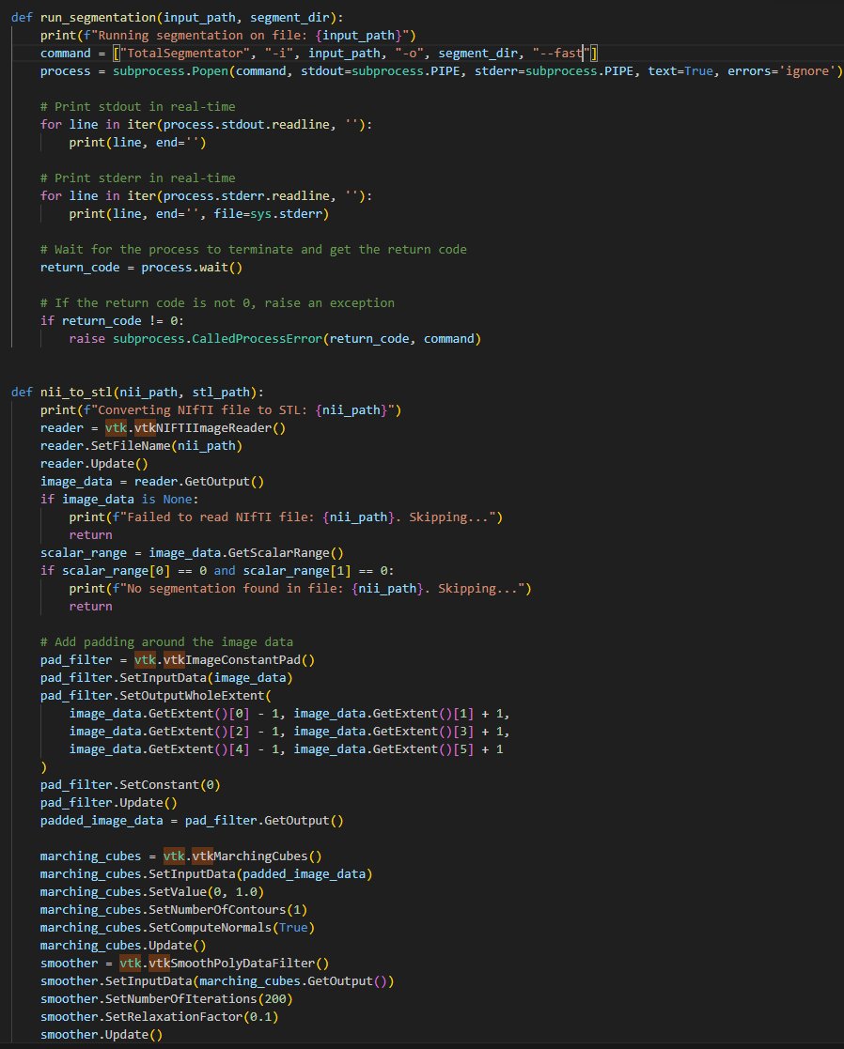
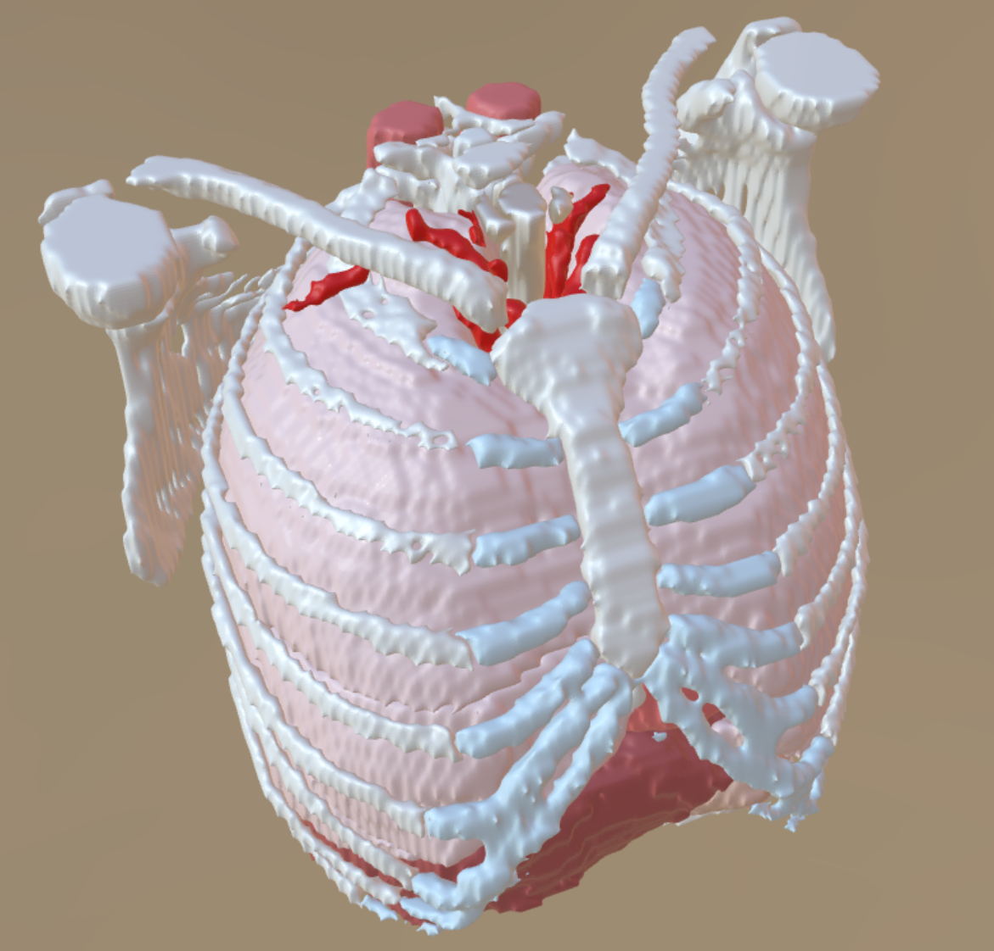
Ask Chat GPT Slowly…
Did this work immediately ---- NO!
How to resolve:
Look at the output/errors
Look up the specific issues in both AI and regular search
ASK FOR HELP
This was more complicated to work through, but need to break down the steps:
Segment a DICOM set (nii.gz) from a provided location using the TotalSegmentator algorithm
Feed the directory of output nii.gz segmentations into VTK to create a 3D model. There are some specialized parameters for this.
Feed the directory of stl files into Blender to apply materials, rotate the model, center the model, and export as a glb.
170.5 sec from DICOM to GLB file
dicom2glb.py
Notes:
This is more complicated and required some troubleshooting, but the general idea was to use the TotalSegmentator to process a set of nii.gz files. It outputs a set of nii.gz files, one for each organ. I needed to use VTK (a package I’d never used before) to build the models and refine the parameters. I then needed to feed those stls into my previous script, add more materials, rotate the model, center it, then export as a GLB. Did this work immediately – NO! It’s a complicated program that needed refinement. I had to look at the product, look at the errors, then use AI, forums, and my own knowledge of these subjects to get to an endpoint. At one point I was a bit stuck. All of the models were open at the tops because that’s where the images ended. AI didn’t know what to do. So I asked a colleague who knew VTK better what I could do and he gave a me a general thing I could do that I then used AI to help me implement. In the end, it took 170.5 sec to go from the dicom to this GLB file that has around 80 anatomical parts. From here, this is a fine product for a lot of my applications, but you could easily refine this in Zbrush etc., to have a more polished result. You also have all the files from each step if you want to refine at any stage, and you can break apart the script to run just parts of it. This is referred to being “modular” and is one of the strengths of Python. You should always write your code in a “modular” way.

Slide 16
Take home message
You can automate many things to add efficiencies to your day-to-day work
If you don’t know how to code, AI is a TREMENDOUS assistant.
Start with small projects, and build from there
Notes:
You might be feeling overwhelmed at this point, so take a step back to our first example which was relatively simple. Each larger program is made up of several more simple tasks. I want the take how to be that this is useful, you can automate many things, and AI is a great tool to start. Start small, and you’ll slowly start developing more complex programs.

Slide 17
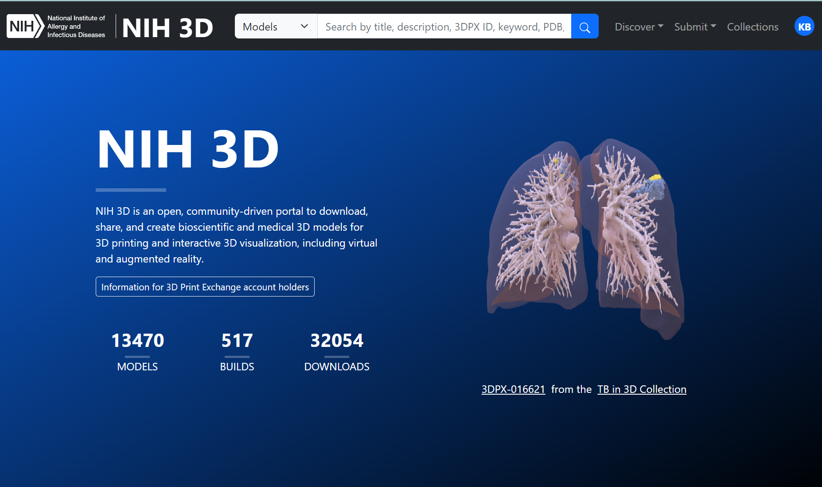
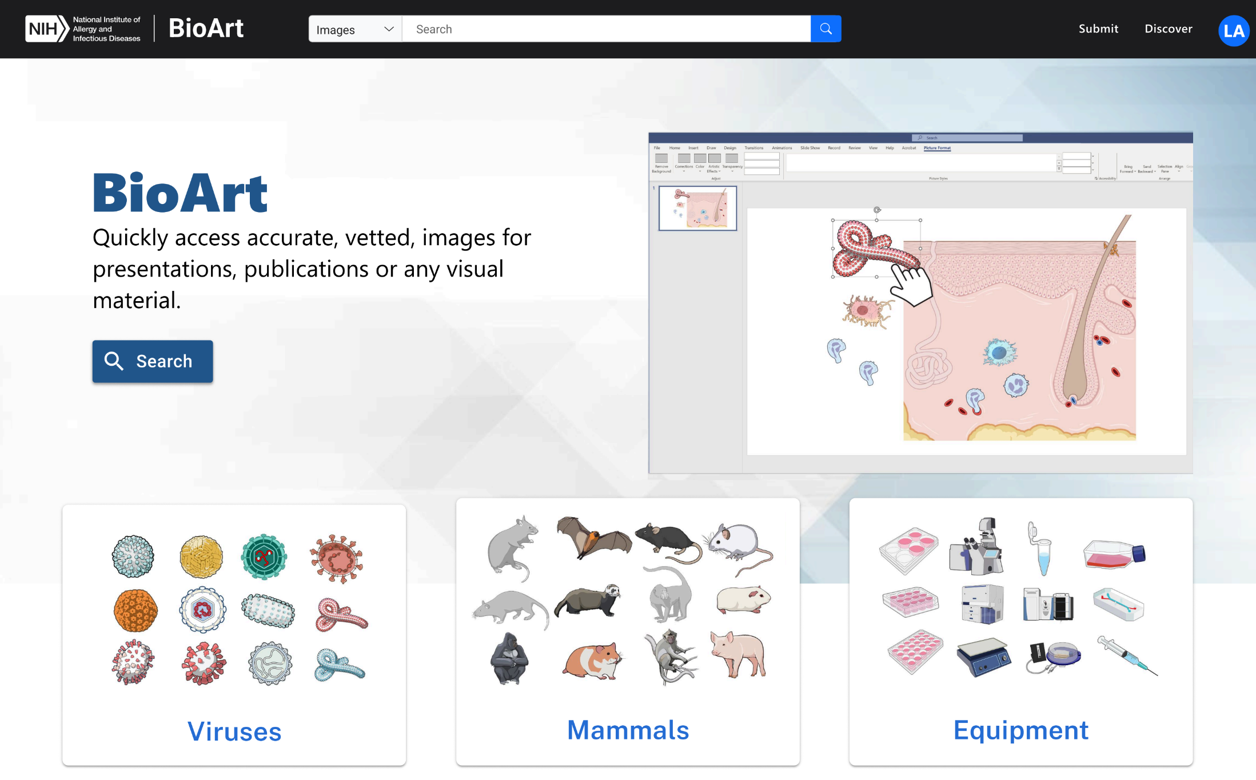
Plug Our Software Products
NIH 3D (Ongoing Development)
3D Model Repository and 3D Model Creation Tools
BioArt (In Development)
Free Accurate and Vetted Science Graphics
Features
Deposit a 3D model and we convert it into several formats and render an image
Deposit molecular data and we process it into several representations in several formats and render an image
Perform automated mesh repair (experimental)
DOI Assignment
Features
Users can search for and download from over a thousand graphics generated by the NIAID Medical Arts team
On request we may add graphics from other groups if they meet the standards of the archive.
Notes:
Before I end, I need to give a shameless plug for our products that I’ve developed code for. NIH 3D is our model repository and creation site. We’re working on getting the new workflows I wrote up and running in prod and these will add a bunch of new formats and features. A new project that is coming out, likely in the late fall or early winter, is BioArt which is a graphics library from our team in Montana. It will have thousands of copyright free images for use in your projects.

Slide 18
Thank You
URL to GITHUB REPO
kristen.browne@nih.gov
python.org/about/gettingstarted/
My Environment: Anaconda (Package Manager), Windows 11, Python 3.11.9, Visual Studio Code or PyCharm (IDE)
Notes:
With that, thanks you for having me. Here are some useful links. Please reach out with questions. I sometimes peek in on the AMI forum as well if you want to have a more public conversation.

